Slide 1
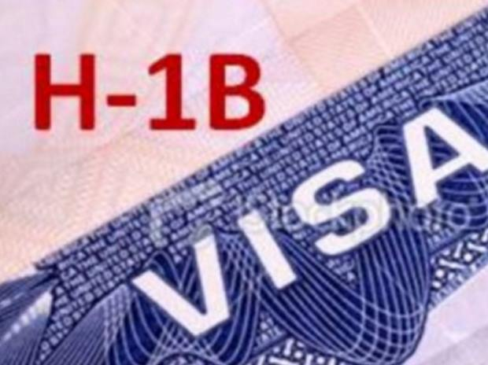



H1B Visa Analysis: A Resource for Career Departments in Colleges and Universities
Presented by:
Joir Gomez Kamphuis Jay Dangi Bowen Ma

Slide 2
Content
Intro/Background
Career Departments: Colleges and Universities
Data
Data Analysis:
General Employer
Location-Based
Data Science Related
Conclusion

Slide 3

Intro/ Background
The H-1B program allows companies in the United States to temporarily employ foreign workers in occupations that:
Require the theoretical and practical application of a body of highly specialized knowledge and a bachelor’s degree or higher in the specific specialty, or its equivalent.
H-1B specialty occupations may include fields such as science, engineering and information technology.

Slide 4

Career Departments at Colleges and Universities
Career Decision Making
Career Exploration
Resume/ Letter writing
Recruiting
Internships
Career Advisement
H1B Visa Assistance
Application of data analysis for marketing strategies to attract more international students.

Slide 5
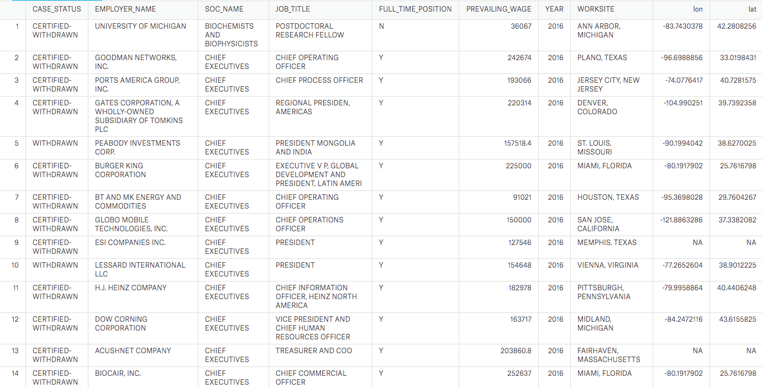
Data

Slide 6
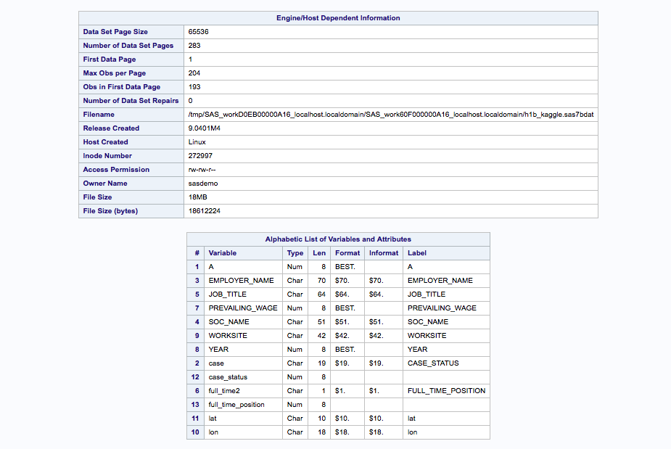
Data

Slide 7
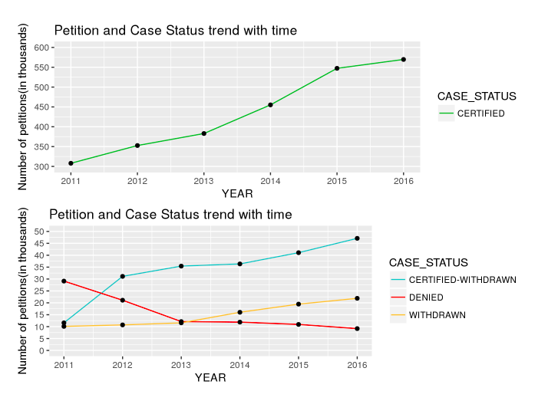
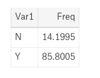
Case_status And Full_Time

Slide 8
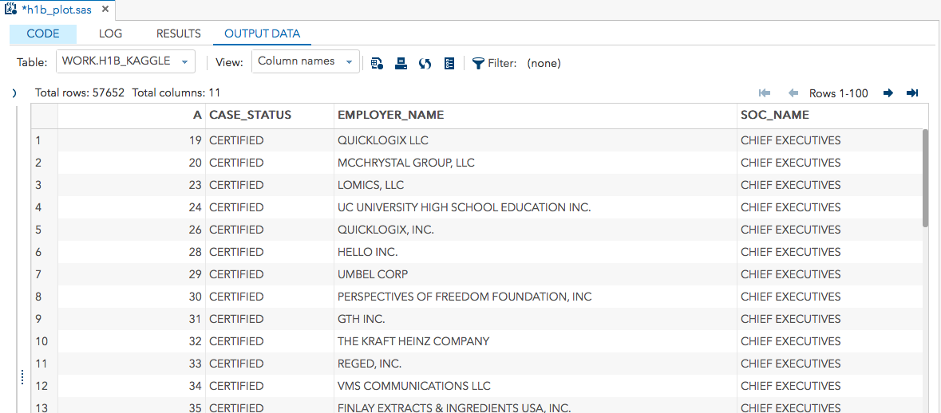
Our Cleaned Data Based on “Certified” case_status(Target Variable).

Slide 9
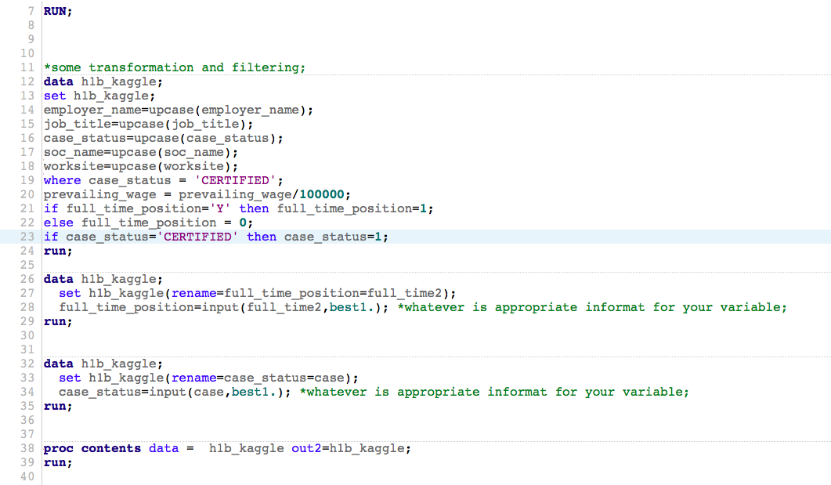
Code for data cleaning and filtering

Slide 10
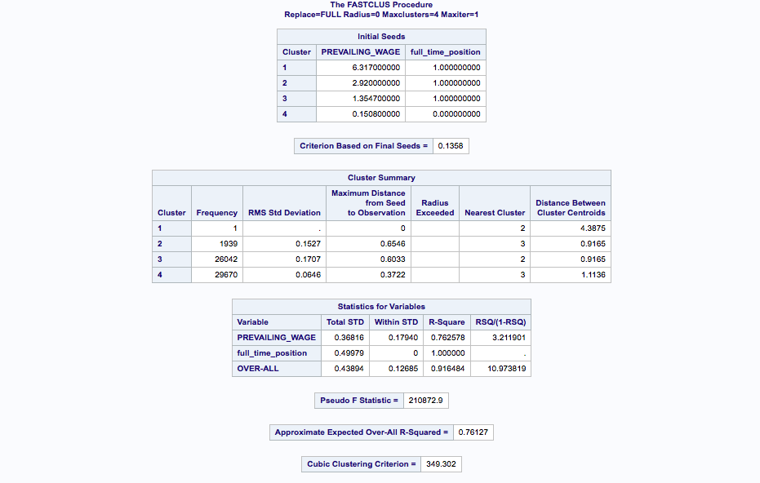
KNN Result(Proc Fastclus)

Slide 11
Analysis Outline
Section I. General Employer Analysis
Section II. Location-Based Analysis
Section III. Data Science related Analysis

Slide 12
General Employer Analysis

Slide 13
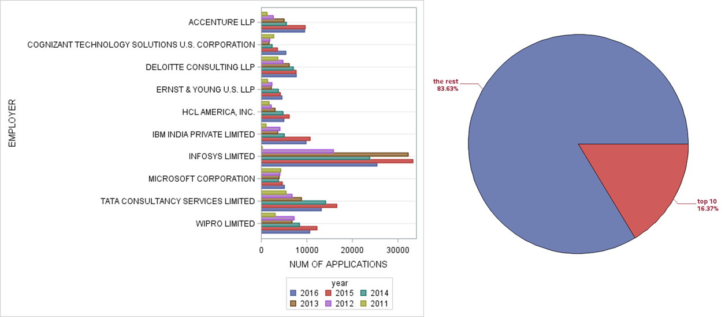
Number of applications
for top 10 companies by year

Slide 14
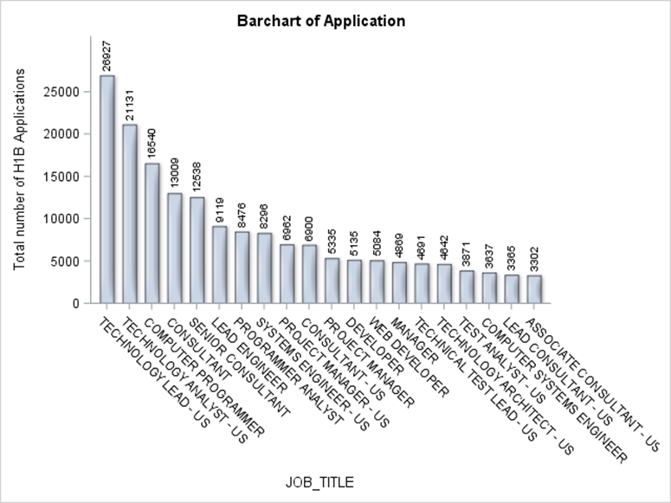
Top job titles for the top ten employers

Slide 15
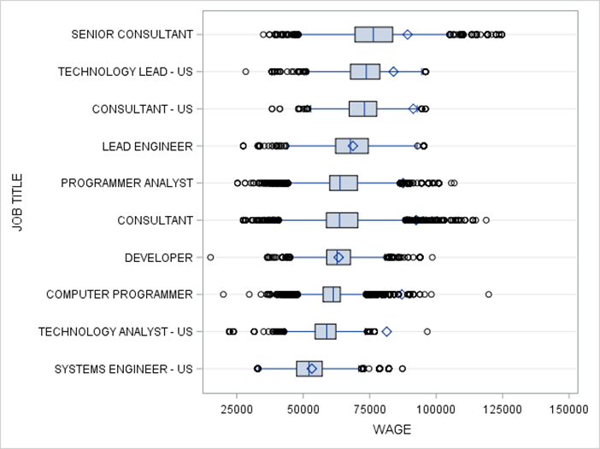
Wage distribution for top ten jobs

Slide 16
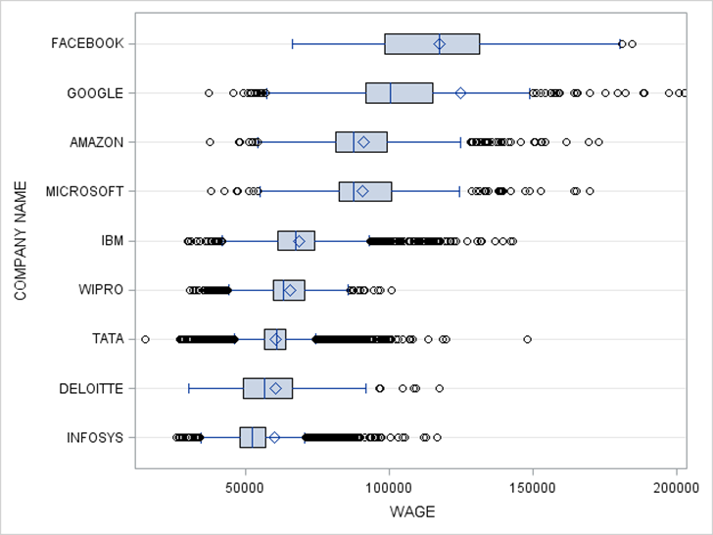
Compare the wage with top software companies

Slide 17
Location-Based Analysis

Slide 18
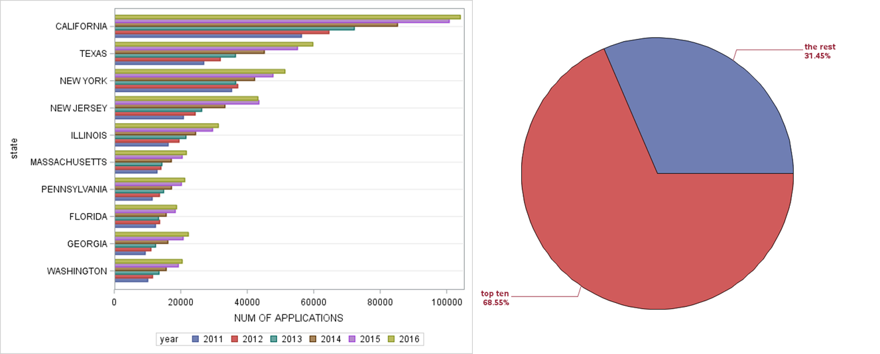
Top 10 States with highest number of applications

Slide 19
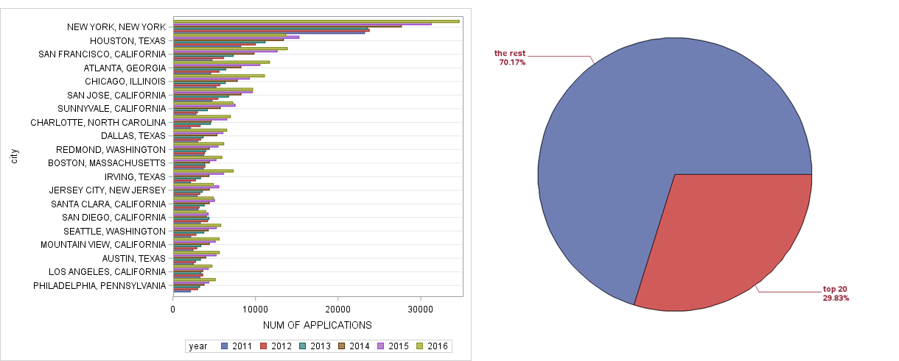
Top 20 cities with highest number of applications

Slide 20
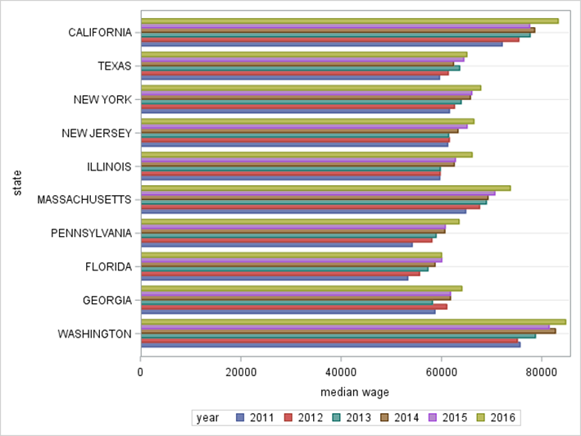
Median Wage by Year for the top ten states

Slide 21
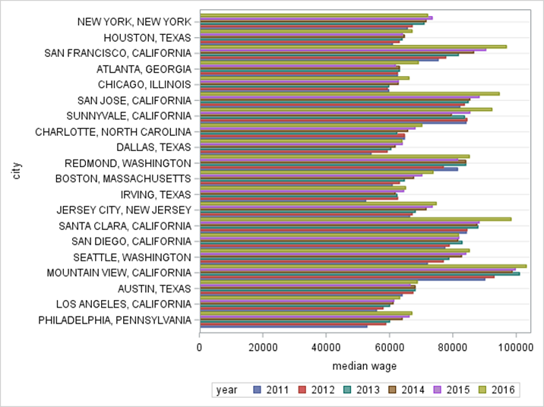
Compare Median Wage among top ten cities

Slide 22
Data Science related Analysis

Slide 23
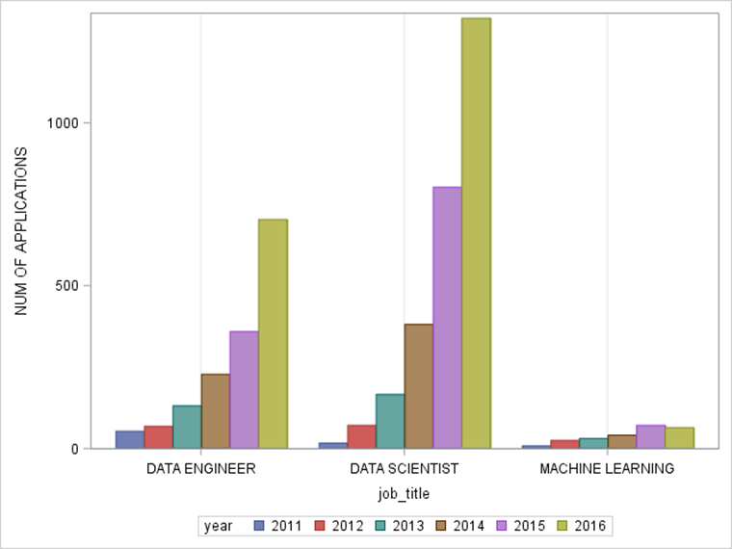
Number of Applications by year for DS jobs

Slide 24
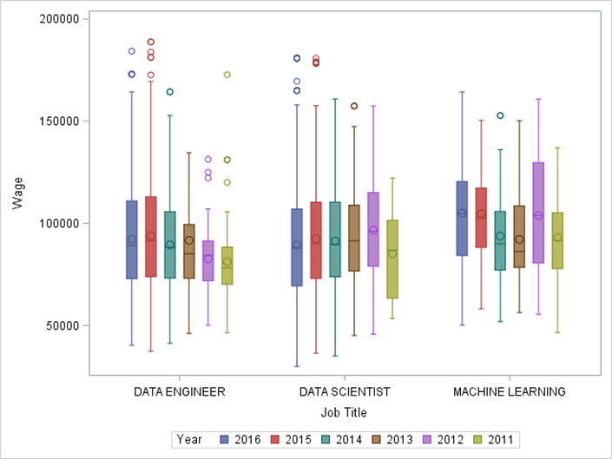
Wage Distribution By Year for DS related positions

Slide 25
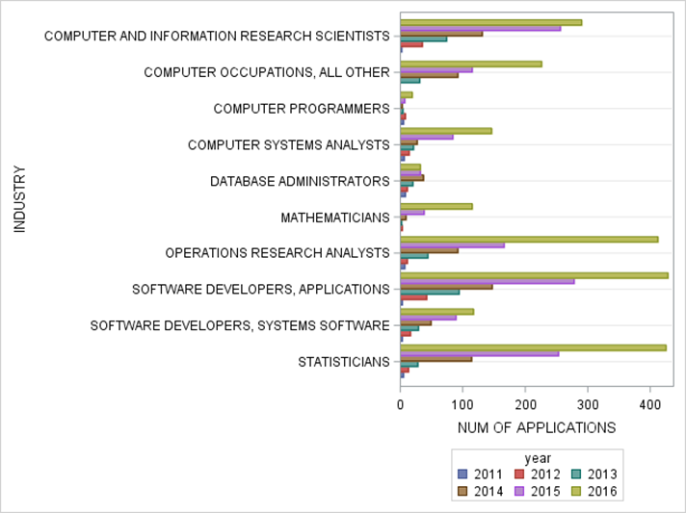
Top ten industries for DS positions

Slide 26
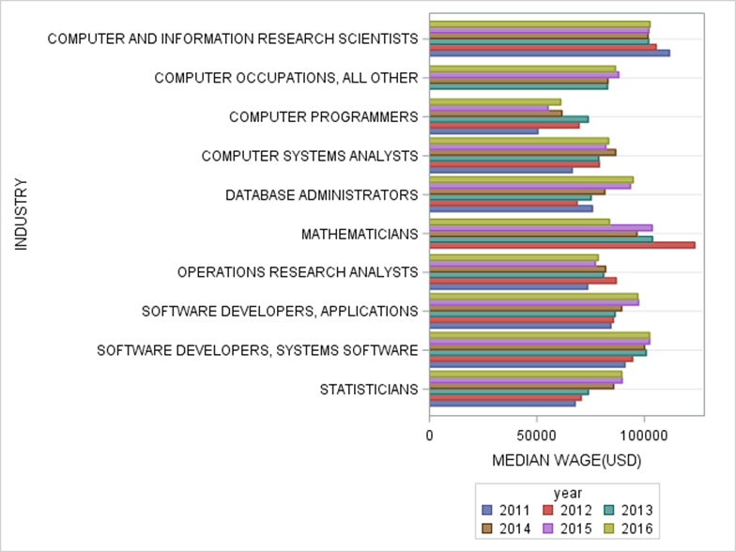
Median wage for DS position in top ten industries

Slide 27
Takeaways for future data scientists who need h-1b
You will have better chance to get hired for a high-wage job with h-1b sponsorship if you start working on your computer science related knowledge and skills.
Seattle, Silicon Valley and New York City might be where you will end up working.
If you want to stay in New York, Manhattan will be your best bet.
If you want to stay in CA, you can choose from multiple cities.

Slide 28
Thank You!

